Slide 1
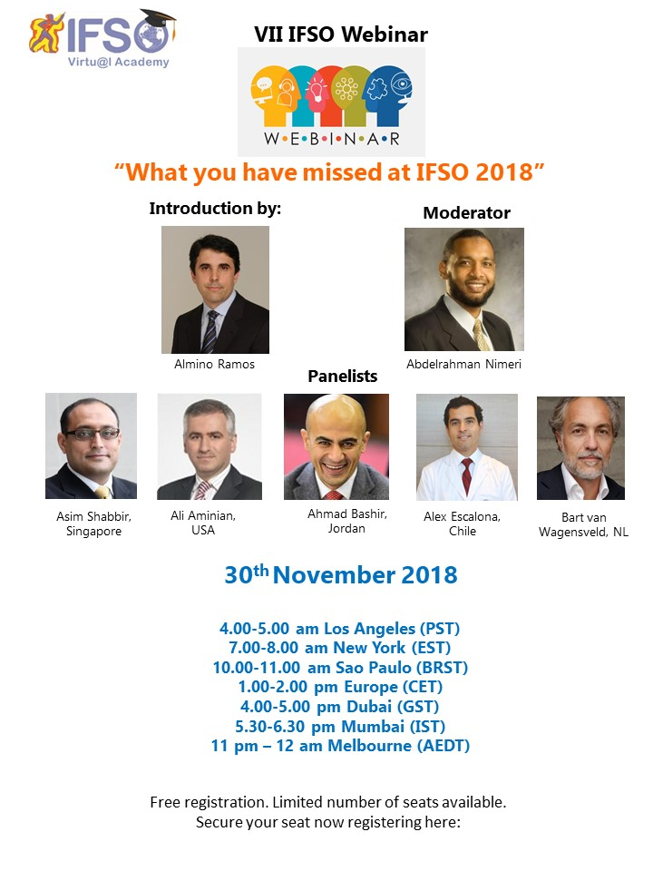


Slide 2
30.6%% oral presentation acceptance rate

Slide 3
30.6%% oral presentation acceptance rate

Slide 4
30 best studies @IFSO2018 out of 370 oral abstracts

Slide 5
9 Randomized Controlled Trials
10 Registry studies
3 Matched case control studies
4 Non matched controlled studies
3 others (retrospective & survey based)
30 best oral abstracts out of 370

Slide 6
9 Randomized Controlled Trials

Slide 7
1. WEIGHT LOSS RESULTS AT ONE YEAR FOLLOW UP IN THE DUTCH COMMON CHANNEL TRIAL (DUCATI). DOES SMALL BOWEL LENGTH INFLUENCE RESULTS? R. Gadiot Netherlands
Aim: Iinvestigate the effect of common channel (CC) length in gastric bypass surgery; very long Roux limb (VLRL-RYGB) vs standard (LRYGB)
Methods: 444 patients VLRL-RYGB with a ﬁxed CC length of 100cm, a 60cm (BPL), and variable alimentary limb length versus standard LRYGB with a standard roux limb of 150cm, a 60cm BPL, and a variable CC length.
Results: 1 year FU mean percentage excess BMI loss (%EBMIL) was not different 84% in the VLRL-RYGB group and 85% in the LRYGB group.
Mean percentage total weight loss (%TWL) is 34% in both groups.
2 yr preliminary results: VLRL-RYGB vs LRYGB %EBMIL= 86% vs 83% (ns),
%TWL; 35% vs 32% (sign) 30 day reoperation rate for complications is in VLRL-RYGB group 5% versus LRYGB group 3%
Conclusions: At 1yr follow up no signiﬁcant difference in weight loss was found between both groups. Prelininary results after 2 yr slightly better for VLRL-RYGB No results regarding deficiencies.

Slide 8
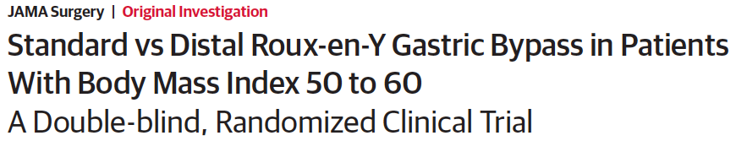

Make the Roux limb longer while keeping BPL constant
Standard RYGB (Roux limb, 150 cm) and distal RYGB (common channel, 150 cm), both with a BPL of 50 cm and a gastric pouch of about 25 mL.
The number of adverse events and changes in health-related quality of life did not differ between the groups.

Slide 9
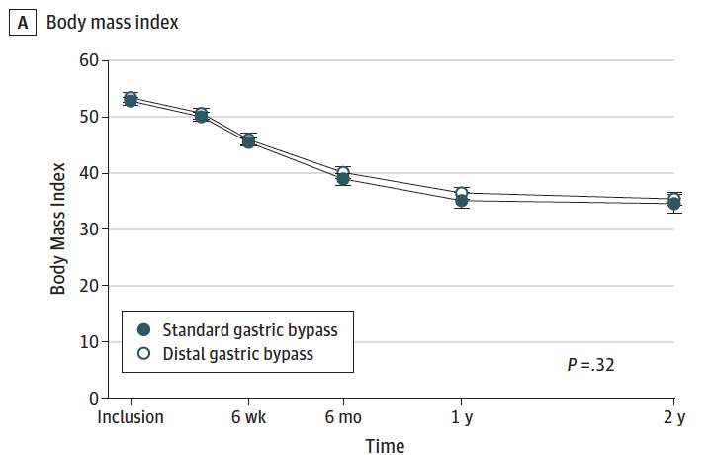
Make the Roux limb longer while keeping BPL constant

Slide 10
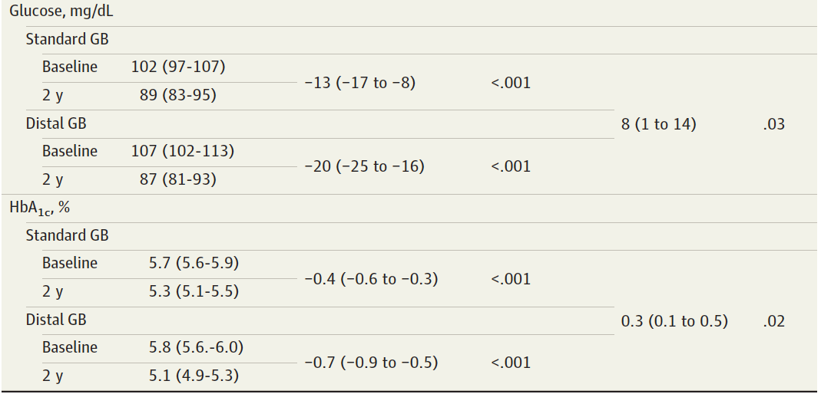
Make the Roux limb longer while keeping BPL constant

Slide 11
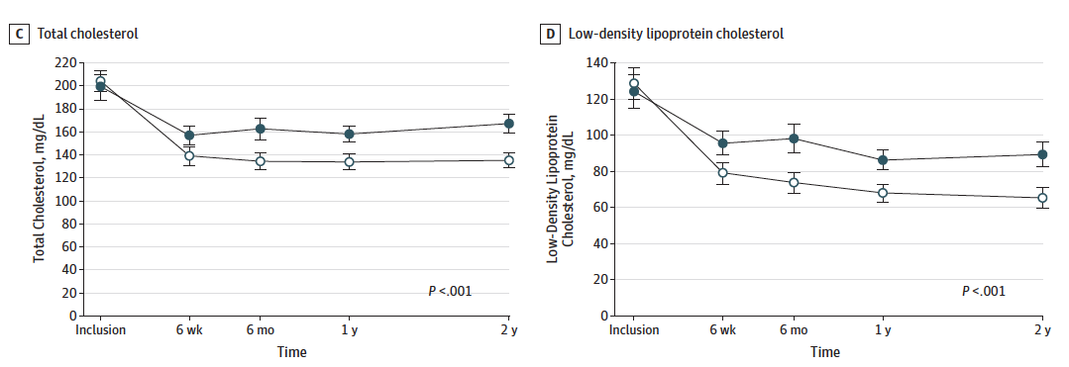
Make the Roux limb longer while keeping BPL constant

Slide 12
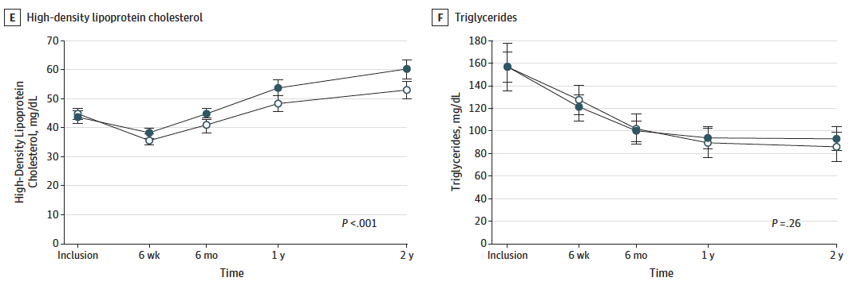
Make the Roux limb longer while keeping BPL constant

Slide 13
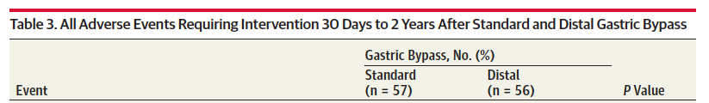
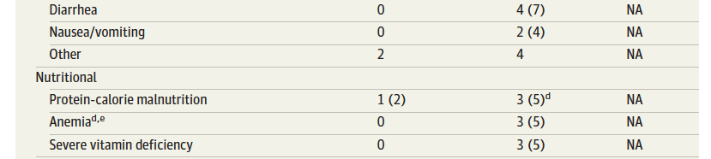
Make the Roux limb longer while keeping BPL constant
After distal bypass: 1 patient had liver failure & 2 patients developed protein-caloric malnutrition treated by elongation of the common channel.

Slide 14
Make the Roux limb longer while keeping BPL constant
In Distal RYGB: Liver failure in 1 patient & protein-caloric malnutrition in 2 patients treated by elongation of the common channel, secondary hyperparathyroidism and loose stools were more frequent after distal gastric bypass.
Distal gastric bypass was not associated with a greater BMI reduction than standard gastric bypass 2 years after surgery.
However, we observed different changes in cardiometabolic risk factors and nutritional markers between the groups.

Slide 15
2. Multi-centric Prospective Randomized Trial Comparing SADI-S vs. Duodenal Switch. Mid-Term Follow-Up Results Ruiz De Gordejuela, A.G et al. Spain
Methods: Multicenter RCT included patients with BMI 50 to 60kg/m² with no previous bariatric surgery. Designed as non-inferiority trial.
Results: 88 patients. Both groups were comparable in terms of age, sex, BMI and comorbidities.
Only surgical time showed any significant difference (152.38 min for DS vs. 117.27 min for SADI-S, p<0.001).
No significant difference in morbidity (12.2% vs. 11.6%), hospital stay (4 vs. 4.3 days) and reoperation rate (9.1% vs. 5.7%). There was no mortality. No significant difference in weight loss up to 2 years; Better weight loss for DS after 3 years.
BMI reduction was greater for DS (53.57kg/m² to 29.05kg/m²) compared to SADI-S (53.24kg/m² to 33.88kg/m²). TWL was 46.95% vs. 36.61% respectively.
One reoperation for complication after DS but none for SADI-S.
Conclusion: Preliminary results show that SADI-S has slightly better safety profile and a faster procedure than DS. However, DS results in better weight loss, with statistical difference after 3 years.

Slide 16
3. Impact of Implementation of ERAS in LRYGB prospective RCT. J.Ruiz-Tovar Madrid Spain
RCT for all the patients undergoing RYGB (ERAS or Standard Care).
Patients were randomized into 2 groups: 90 patients following an ERAS program(ERAS) and 90 patients following a Standard Care protocol(SC).
Postoperative pain, nausea or vomiting, morbid- ity, mortality, hospital stay and analytical acute phase reactants 24h after surgery were evaluated.
Postoperative pain (16 vs 37mm; p<0.001), nausea or vomiting(8.9% vs 2.2%;p=0.05) & LOS (1.7 vs 2.8 days; p<0.001) were significantly lower in the ERAS group.
There were no significant differences in complications, mortality and readmission. WBC, serum fibrinogen & CRP levels were significantly lower in the ERAS group 24h after surgery.
Conclusion: The implementation of an ERAS protocol is associated with lower postoperative pain, reduced incidence of postoperative nausea or vomiting, level of acute phase reactants and earlier hospital discharge. Complications, reinterventions, mortality and readmission rates are similar to that achieved without ERAS.

Slide 17
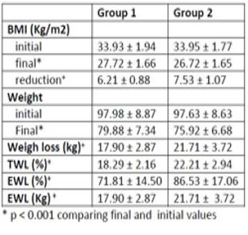
4. Combined treatment of overweight with Intragastric balloon and Liraglutide at high does R. Fittipaldi et al Campos Brazil
RCT of 90 patients (64 females) with BMI >27 to either Orbera IGB for 6 months vs Orbera IGB plus addition of Liraglutide 3.0
The mean age was 34.4 (21-57), the mean initial BMI in group 1 was 33.93 and in group 2, 33.95.
42 patients in group 1 completed treatment compared to 31 patients in group 2.
The results regarding the initial and final BMI, total weight loss (TWL), excess weight loss (EWL), weight loss in kilograms (kg) are shown in table 1.
Conclusion: Both treatments are effective in promoting weight loss; however, the combination with liraglutide promotes an even greater weight loss without increasing complications. Liraglutide shows to be a great adjuvant drug for the intragastric balloon therapy.

Slide 18
5. SHORT TERM RESULTS STUDY OF THE EFFECT OF LAPAROSCOPIC MINI GASTRIC BYPASS VERSUS SLEEVE GASTRECTOMY ON OBESE TYPE 2 DIABETICs H. Elmaleh et al Egypt
To compare OAGB and SG regarding the efficacy of control of T2D in obese patients.
Patients and Methods: a RCT was on 162 obese (BMI>30 kg/m2) patients with type 2 D.M randomly divided into two groups, group (1): treated by LSG, group :2 treated by OAGB
Results: 1-year FU of all included patients had shown that OAGB had a better effect than SG in DM remission detected by a larger drop of mean fasting blood sugar after one year of OAGB (37.80± 6.41 mg/dl) in comparison to LSG (29.93 ± 12.84 mg/dl) (p value <0.004).
The mean HBA1c drop after one year in OAGB (2.33 ± 0.48 %) was larger than in LSG (2.01± 0.59 %) (p value <0.024).
Effect of MGB on diabetes resolution was faster than SG reflected by the percent of cases with early diabetes resolution at 6 months (46.7% with MGB in comparison to 20% with SG).
Conclusion: OAGB has better and earlier effect than SG in diabetes remission. Oral hypoglycemic medications, C peptide >3 ng/ml and diabetes duration < 5 years are considered independent predictors for diabetes resolution after the operation.

Slide 19
6. BAND AND EXTEND? RESULTS OF 2 RANDOMIZED CONTROLLED TRIALS ON RYGB IMPROVEMENT A. Boerboom et al Netherlands
Aim: to evaluate the effect of a banded RYGB (B-GB) & an extended RYGB (EP-GB).
Methods: In both (RCTs) the modified RYGB (B-GB and EP-GB) was compared with a S-GB. In each study 130 patients were randomized into two groups. Subsequently, weight loss, morbidity, reduction of comorbidities & QOL were measured during a FU of 2 years. The B-GB was created using a non-adjustable MiniMizer silicone ring and in the EP-GB a 15 cm long pouch was formed.
Results: In the first study, mean EWL after 24 months was 88% in the B-GB group versus 80% in the S-GB group (p=0.212) & in the second study, mean EWL was 77% in the EP-GB versus 73% in the S-GB group (p=0.437).
In 4 (6%) patients the MiniMizer ring was removed because of persistent dysphagia. No differences in other complications and nutritional deficiencies were found in both studies.
Conclusion: Two years after surgery, no significant difference in weight loss were detected between the B-GB, EP-GB and S-GB group. Extension of follow-up of both RCTs is needed to assess if modifications of the gastric pouch may prevent weight regain in the long term.

Slide 20
7. BANDED SLEEVE GASTRECTOMY – 2 YEAR RESULTS OF THE MISO (MINIMIZER FOR SLEEVE OPTIMIZATION) TRIAL J. Fink et al Germany
Aim: Single center RCT to see if banding a sleeve leads to better weight loss or not.
Methods: 94 patients were randomized to undergo banded LSG (BLSG) using a MiniMizer® ring closed at 7.5 cm, or a conventional LSG with 2 year analysis for safety, weight loss, reflux and postoperative regurgitation.
Results: Mean preoperative BMI was 50.55 ± 6.2 kg/m2 in BLSG and 50.69 ± 6.5 kg/m2 in LSG (Mann- Whitney p = 0.9).
There was no postoperative complication in either group. 2 patients in the BLSG group and 1 patient in the LSG group were converted to gastric bypass.
There was no difference in weight loss 2 years after surgery (%BMI loss BLSG 75.61 ± 19.39 vs. LSG 68.82 ± 17.19; p = 0.20). Ring placement had no impact on presence of reflux symptoms (Fisher´s exact test p = 0.14) at that time. The rate of postoperative regurgitation was not increased for BLSG patients (Fisher´s exact test p = 0.24).
Conclusion: Ring placement had no impact on reflux or weight loss 2 years after surgery.

Slide 21
8. THE USE OF INTRAPERITONEAL BUPIVACAINE IN LAPAROSCOPIC ROUX-AND-Y GASTRIC BYPASS: A DOUBLE BLIND, RANDOMIZED CONTROLLED TRIAL Schipper et al Netherlands
127 RYGB Patients
March Nov 2017
66 Patients
IP Bupivacaine
Sprayed 20 ml on Diaphragm
61 Patients
IP Bupivacaine
0 ml
Vas pain score: Shoulder pain and Abd pain at 0, 1, 6 & 24 hours
Use of opioids & anti-emetics
Conclusion: No difference between two groups
Of Note: Symons et al, 2007 in JACS, double-blinded RCT showed
reduction in oral opioid use POD 1

Slide 22
9. STAPLE LINE REINFORCEMENT USING SEAMGUARD VERSUS OVERSEWING SUTURE DURING LAPAROSCOPIC SLEEVE GASTRECTOMY RCT H Elghadban et al Egypt
Objective: To evaluate the effect of using Seamguard material for reinforcement of the staple line during LSG for super morbid obese patients and comparing it with reinforcing the staple line by over-sewing using suture
Methods: A RCT 200 super-morbid obese patients randomized into two groups; group (1) with reinforcement of the staple line by seamguard and group (2) in with reinforcing the staple line using suture.
Results: No statisical significant difference in the baseline characteristics of the study groups. Mean operative time was 55± 8 minutes in group (1) while in group (2) was 75±17 p value (0.05). intraoperative blood loss was significantly reduced in group(1). Staple line hematomas were higher in group (2). No difference in postoperative blood loss and the rate of blood transfusion (2 case in both groups).
No leak was reported in both groups. the cost was higher in group(1).
Conclusion: Reiforcing the stable line in laparoscopic sleeve gastrectomy using suturing is equal to Seamguard in all aspect except shorter operative time with seamguard.

Slide 23
10 Registry studies

Slide 24
10. Long term results of RYGB vs LSG a prospective score matching analysis
C Stroh Magdeburg Germany
All patients who had undergone primary SG and RYGB for morbid obesity within a 13 year period from the German registry started in 2005.
LSG 21,571
BMI reduction 15.3 (7.4)
DM remission 53%
RYGB 22,409
BMI reduction 15.1
DM remission 46.6%
Conclusion: FU data of patients after SG and RYGB show in propensity score matching analyzes only differences in the amelioration of diabetes mellitus type 2.
Therefore both procedures are without any relevant difference in patients without metabolic diseases.
For patients with metabolic comorbidities RYGB and malabsorptive procedures should be the first choice.

Slide 25
11. LEAK AT GASTROJEJUNOSTOMY AFTER RYGB 40,844 PATIENTS FROM THE SCANDINAVIAN OBESITY SURGERY REGISTRY (SOREG) B. Vidarsson et al Sweden
Background: Leak at the (GJ) after (RYGB) is a serious & potentially life-threatening.
Method: All leaks at GJ within 30 days in 40,844 patients between 2007-2014 in SORegistry.
Results: Leak at GJ in 262 patients, Mean age 44.5 years, BMI 42.4 kg/m2 and 63.7% females).
Incidence of GJ leak: 0.6 %, 44% of leaks were diagnosed within the first 3 Post op days.
Risk factors: age above 50 years (OR 2.1), male (OR 1.6) and diabetes (OR 1.5).
BMI and smoking were not significant risk factors. Surgery required in 85% (perioperative suture of the leak attempted in 45% of patients, gastrostomy was performed in 24%).
Stents were placed in 31% of leaks. No surgical intervention in 7%.
25% required intensive care, 4% developed multi organ failure, 1% died.
Mean length of stay for patients with leaks 21.9 days vs. 2.0 days for others (p<0.001).
Conclusion: Leaks occurred in 0.6%. Risk factors were age >50 years, male gender and diabetes. Patients with leak required longer LOS & interventions but mortality was low.

Slide 26
12. READMISSION RATE IN BARIATRIC SURGERY: A NATIONWIDE STUDY ON 320.000 PATIENTS A. Lazzati et al. Paris, France
National administrative databases - comprehensive of all bariatric procedures in all French hospitals
The criteria for identifying unplanned readmission were established by a committee of experts
Results: 2016, out of 53,000 bariatric interventions (Ave. readmission rate was 4.5%).
About 1/3 patients were treated in a different hospital than the original center.
Significant association between bariatric technique and unplanned re-hospitalization (after LAGB: 2.7%, after SG: 4.0%, bypass: 6.0% and bypass: 8.0%).
The main causes of return to hospital are: abdominal pain, leak / peritonitis, vomiting, dysphagia.
Conclusion: This study found a rate of non-scheduled readmissions after bariatric surgery of 4.5% on average. The main causes are digestive complications. A great variability is found between different hospitals.

Slide 27
13. Bariatric Surgery is Associated with Lower Rate of Death after Heart-Attack and Stroke: A Nationwide Study Aminian, A. et al.
Objective: To assess the impact of bariatric surgery on mortality after future cardiovascular events.
Methods: NIP was used to match bariatric surgery patients with MI (n=2218 patients) or CVA (n=2168 patients) with controls without bariatric surgery who had also suffered MI or CVA. Controls divided into control group-1 consisted of patients with obesity (BMI > 35), and control group-2 that were matched with bariatric surgery group according to post-surgery BMI.
Results: Total of 48,246 (weighted) patients included in analysis. Mortality rates after MI and CVA were significantly lower in patients with bariatric surgery compared to both control groups.
LOSwas also significantly shorter for the bariatric surgery group (p<0.001).
Conclusion: Bariatric Surgery has a significant protective effect on survival after MI and CVA.

Slide 28
14. CENTRALIZED MANAGEMENT OF POSTOPERATIVE EARLY COMPLICATIONS AFTER BARIATRIC SURGERY TO REDUCE MORTALITY: A FRENCH NATIONWIDE STUDY INCLUDING 297,668 PATIENTS R. Caiazzo et al
Early postoperative complications are associated with mortality. Early referral might help.
Data were extracted from the French national prospective database providing information on all hospital stays, irrespective of hospital affiliation, public or private.
Results: Between 2009 and 2016, 297 668 bariatric procedures have been included (NPC = 8%) in this study. Since the implementation of the Osean network, mortality rate in NPC vs the rest of France was 0.03% vs 0.08% at 90 days (p<0.001).
In multivariate analysis, 90-day mortality rate in NPC was similar to the rest of France before 2013 (p=0.340), but lower after 2013 (p=0.041).
The other predictive factors of mortality were: age (p<0.001), male gender (OR 1.99, p<0.001), type of intervention (SG OR=1.00 (ref), GBP OR=2.10, band OR=0.26; p<0.001) and severe comorbidities. If applied nationwide with similar results, this organization may have divided by 3 the number of death in 4 years.
Conclusion: Centralized care for early postoperative complications after bariatric surgery increased safety of bariatric surgery by reducing overall mortality.

Slide 29
15. A COMPARISON OF PRIMARY CARE RESOURCE UTILIZATION BEFORE & AFTER BARIATRIC SURGERY IN A PUBLICLY FUNDED HEALTH SYSTEM Y. Chanada et al Canada
Objectives: To determine whether the number of patient visits to family physicians decreases in the 3-year period after bariatric surgery, compared to the 3-year period before surgery.
Methods: A population-based, retrospective cohort study of patients who underwent RYGB or SG in publicly funded hospitals in Ontario, Canada between 2010 and 2012.
Results: 6416 patients met inclusion criteria: 5947 RYGB (92.7%) and 469 SG patients (7.3%). There was no difference in the median number of patient visits to their family physician within the 1-year period before surgery as compared to the 1-year period after surgery (4 vs. 4, p=0.58). However, there was a statistically significant decrease in the median number of patient visits in the 1-2 year period (5 vs. 3, p <0.0001) as well as the 2-3 year period before and after surgery (4 vs. 3, p<0.0001). When combining the corresponding 1-2 year and 2-3 year periods before and after surgery, there was a 19% decrease in family physician visits after bariatric surgery (CI 0.79 – 0.82, p<0.001).
Conclusion: In Ontario, Canada, bariatric surgery significantly decreases the number of patient visits to family physicians in the 1-3 year period after surgery, as compared to the. corresponding time periods before surgery.

Slide 30
16. Perioperative outcomes of primary bariatric surgery in North-Western Europe: A pooled Multinational registry analysis Y. Poelmeijer et al Sweden/Netherlands Norway
Objectives: evaluate the rate and type of complications after primary bariatric surgery
in three North-Western European countries using nationwide registries.
Methods: Data from 3 registries for bariatric surgery were used (2015-2016). All registries
have nationwide coverage with data on patient characteristics & perioperative complications. Eligibility criteria for bariatric surgery were similar and included body mass index of >40.0 kg/m2, or >35.0 kg/m2, with one or more obesity associated diseases.
Results: A total of 35,858 procedures (32,177 primary) were registered. The most common procedure was RYGB in the Netherlands (78.9%) & Sweden (67.0%), and SG in Norway(58.2%).
A total of 904 (2.8%) patients developed major complications after primary surgery and 12 patients (0.04%) died within 30 days. Total number of complications between the registries were comparable (p = 0.939). However, significant differences were seen for Clavien-Dindo Classification grades IIIb and IV (p < 0.001). Pooled readmission rates were 4.3% (n=1,386).
Discussion: Bariatric surgery is safely performed in the three evaluated countries. Standardization of registries and consensus of variables are essential for

Slide 31
17. BARIATRIC SURGERY DID NOT INCREASE THE RISK OF GALLBLADDER DISEASE IN OBESE PATIENTS: A COMPREHENSIVE COHORT STUDY Jinan-Han Chen et al Taiwan
Aim is to evaluate the influence of bariatric surgery on gallbladder disease in obese patient using the Taiwan National Health Insurance Research Database.
All patients 18-55 years of age with a diagnosis code for obesity between 2003 and 2010 were included.
Patients with a history of gallbladder disease and hepatic malignancies were excluded.
The patients were divided into non-surgical and bariatric surgery groups by ICD 9 codes.
We also enrolled healthy civilians as the general population. The primary end point was defined as rehospitalization with a diagnosis of gallbladder disease after the index hospitalization & all patients were followed until the end of 2013, a gallbladder disease occurred, or death.
Results: 2317 patients in the bariatric surgery group, 2331 patients in the non-surgical group, and 8162 patients in the general population were included.
Compared to the non-surgery group (2.79%), bariatric surgery (2.89%) did not elevate the risk of subsequent gallbladder disease (HR=1.075, p=0.679).
Compared to the general population (1.15%), bariatric surgery group had a significantly higher risk (HR=4.996, p<0.001). In the bariatric surgery group, female gender (HR=1.774, p=0.032) and a restrictive procedure (HR=1.624, p=0.048) were risk factors for gallbladder disease.
Conclusion: The risk for gallbladder disease did not increase after bariatric surgery, although the risk was still higher than the general population ? benefit of concomitant cholecystectomy.

Slide 32
18. Relationship between individual physician volume, hospital volume and short term outcomes after primary bariatric surgery Y. Poelemejer et al Netherlands.
Data were obtained from the Dutch Audit for Treatment of Obesity (DATO), a specific nationwide database including 18 Dutch bariatric hospitals participate for patients undergoing a primary bariatric procedure between 2015 and 2018 were included for analyses.
Hospitals were divided into 3 groups over 3 years in terms of volume; low volume hospitals (< 1500), medium volume hospitals (1500-2500) and high volume hospitals (>2500 procedures).
Results: A total of 27,002 (91.5%) of the 29,497 primary bariatric procedures were assigned to an individual physician, with a range of 4-969 procedures per physician.
In total, seven low volume hospitals, five medium volume hospitals and six high volume hospitals were identified with a total range of 593 till 3,466 procedures per hospital over three years.
Compared to patients cared for by low-volume physicians, patients operated by high-volume physicians had a lower O/E-ratio regarding 30-days postop morbidity; these effects were independent of hospital volume, though hospital volume maintained its relationship with these outcomes as well.
Conclusion: The volume-outcome relationship for short-term postoperative complications after primary bariatric surgery is driven by both physician volume and hospital volume. This has implications for targeting quality improvement efforts, strategic behaviour and the ways in which minimum volume standards should be established.

Slide 33
19. BARIATRIC SURGERY DECREASES THE RISK OF HEPATOCELLULAR CARCINOMA IN THE OBESE PATIENT: A COMPREHENSIVE NATIONAL COHORT STUDY Jinan-han Chen et al Taiwan
Aim to evaluate the influence of bariatric surgery on the risk of hepatocellular CA in obese patients using the Taiwan National Health Insurance Research Database. All patients 18-55 years of age with a diagnosis code for obesity between 2003 and 2010 were included. Patients with a history of hepatic malignancies were excluded.
The patients were divided into nonsurgical and bariatric surgery groups using ICD-9-OP codes We also enrolled healthy civilians as the general population. The Development of hepatocellular CA which is identified from the Registry for Catastrophic Illness Patient Database, after the index hospitalization was defined as the primary end point. All patients were followed until the end of 2013, a biliary complication occurred, or death.
Results: 4192 obese patients with 71.32 months median followed up were included. 2057 patients were in the bariatric surgery group and 2135 patients were in the non-surgical group. And 8228 patients in the general population were included.
Obese patients in non-surgical group (0.56%) did had higher risk for hepatocellular carcinoma than general population (0.15%) (HR=15.211, p<0.001). Compared to the non-surgery group, bariatric surgery (0.05%) did lower the risk (HR=0.144, p=0.038). Age (HR = 1.196, p<0.001) and cirrhosis (HR=9.379, p=0.001) and hepatitis B (HR=16.904, p<0.001) are the risk factors for hepatocellular carcinoma in obese patients. Moreover, compared to the general population, bariatric surgery group had a similar risk of hepatocellular carcinoma (HR=0.975, p=0.981).
Conclusion: For the obese patient, the risk for hepatocellular carcinoma is higher than the general population in Taiwan. After bariatric surgery, the risk decreased, even like the general population. We believed that bariatric surgery could decrease the risk of newly onset hepatocellular CA in obese patients.

Slide 34
3 Matched controlled studies

Slide 35
20. BANDED SLEEVE GASTRECTOMY SHOWS IMPROVED WEIGHT LOSS 5 YEARS AFTER SURGERY Fink et al
Methods: Retrospective matched pair of 51 patients: LSG Vs BLSG matched for Age & gender Preoperative BMI and Presence of type 2 diabetes, Median follow-up was 5 years
Results:
No effect on GERD symptoms: 36% in BLSG Vs 34% in LSG at 5 years.
5 revised due to GERD.
Conclusion: BLSG had better weight loss at 5 yrs, but no difference in GERD symptoms.
 | BLSG | LSG
Preop BMI | 54.79±8.5 | 53.35±7.7
TWL % 3-yrs | 36.98%±8.69 | 32.40 ± 10.69
TWL % 5-yrs | 37.62% ± 8.51 | 30.10 ± 13.51

Slide 36
21. BANDED VERSUS NON-BANDED LSG: 5-YEAR OUT- COMES
M. Bhandari Mohak India
220 well matched patients had LSG Banded LSG had longer OR time and EBL
68 Patients (31%) Had banded LSG
Bleeding 1.5%
FU @ 5 yrs 81%
No major late complications
152 Patients (69%) Had non banded LSG
Bleeding 0.65%
FU @ 5 yrs 67%
No major late complications
Weight loss was equivalent between groups at 6 and 12 months. Thereafter, weight loss was substantially greater following BLSG compared to LSG at 2, 3, 4, and 5 years, with the magnitude of difference increasing at each successive year.
At 5 years, total BMI decrease was 33.0±12% for BLSG vs. 21.7±18.2% for LSG (P=0.0001).
At 5 years, BLSG patients reported minimal food intoler- ances, very rare postprandial vomiting, no heartburn and 100% satisfaction with our loose-fitting version of BLSG.
Conclusions: Loose-fitting BLSG is safe and produces substantially more weight loss than non-banded LSG at 2 through 5 postoperative years, with minimal side effects.

Slide 37
22. LAPAROSCOPIC SLEEVE GASTRECTOMY VERSUS ENDOSCOPIC SLEEVE GASTROPLASTY: A CASE MATCHED STUDY L Fayad et al USA
Aim: compare the outcomes of ESG versus LSG over 6 months in a case-matched cohort.
Methods: This study was retrospective review of two prospectively collected databases of patients who underwent ESG and LSG at a single academic center.
Patients were matched 3:1 by age, sex, and body mass index (BMI) and evaluated at 1 and 6 months to determine percent total body weight loss (%TBWL), adverse events, and new-onset GERD.
Results: A total of 54 ESG patients were matched to 83 LSG patients. At 1 month follow-up, there was a significantly greater %TBWL in the ESG group than the LSG group (9.8% ± 2.5 vs. 7.5% ± 5.6, p < 0.001). However, at 6 month follow-up, %TBWL became significantly lower in the ESG group than the LSG group (17.2% ± 7.5 vs. 23.9% ±7.8, p < 0.05). ESG patients had a significantly lower rate of adverse events than LSG patients (5.2% vs. 16.9%, p < 0.05). New-onset GERD post-procedure was also significantly lower in the ESG group than the LSG group (1.9% vs. 14.5%, p < 0.05).
Conclusion: LSG results in superior weight loss to ESG at 6 months, however, it was associated with a greater rate of adverse events and new-onset GERD.

Slide 38
4 Non matched controlled studies

Slide 39
23. EFFECT OF HIATAL HERNIA REPAIR ON GASTROESOPHAGEAL REFLUX SYMPTOMS AFTER SG : A PROSPECTIVE OBSERVATIONAL STUDY M. Minhem AUB Lebanon
Primary LSG had Preop EGD, GERD disease & Nocturnal GERD disease Symptom Severity & impact Questionnaire 6,12,24 months
150 consecutive primary LSG patients were enrolled (43.4% males; mean age 37.0±11.7; mean BMI 40.3±4.8 Kg/M2). HHR was performed in 46 patients (31%) according to endoscopic and surgical findings mainly through posterior crural repair (95.6%).
HHR patients were more likely to be males (56.5% vs. 37.5%, p=0.03) and to have erosive esophagitis (EE) (41.3% vs. 23.1%, p=0.02).
Patients with LSG + HHR had similar rate of de novo GER (11.8% vs. 11.4%, p=0.6) and resolution of baseline GER at 6 months vs those with LSG alone (32.4% vs. 21.5%, p=0.2). Total PPI dependence did not change at 6 months post-surgery. Assessment at 1-2 years was completed by 29 patients who underwent HHR+LSG. Compared to baseline, there were no differences in GERDQ scores at 1-2 years. However, N-GSSIQ scores dropped significantly (14.8±13.5 vs. 3.0±3.9, p<0.001).
Conclusions: Loose-fitting BLSG is safe and produces substantially more weight loss than non-banded LSG at 2 through 5 postoperative years, with minimal side effects.

Slide 40
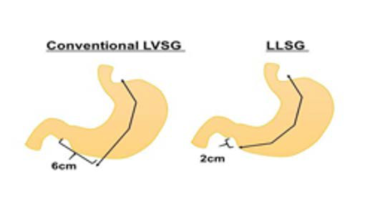
24. Laparoscopic Long Sleeve Gastrectomy: A Novel Alternative Procedure to the Conventional Vertical Sleeve Gastrectomy Soejima, Y. et al. Japan
Objective: To assess the weight loss impact of a shorter resection margin from the pylorus (2 cm) in creating a “long sleeve gastrectomy”.
Methods: 70 patient divided into 2 groups: Conventional SG with resection margin 6 cm from the pylorus (LVSG, n=34), and long sleeve gastrectomy with resection margin 2 cm from pylorus (LLSG, n=36).
Results: Preoperative characteristics including age, gender, BMI, and co-morbidities were comparable between the groups.
No significant difference in complication rates between the two groups.
At 12 months, %EWL was significantly greater for LLSG vs. LVSG (63.2% vs. 51.2%, p < 0.05)proton pomp inhibitor use was significantly lower in LLSG vs. LVSG (5.8% vs. 21.8%, p<0.05).
Conclusion: LLSG leads to better weight loss and gastric emptying property than conventional SC. RCTs comparing the two procedures is warranted.

Slide 41
25. TRANEXAMIC ACID IS SAFE AND EFFICIENT IN AVOIDING BLEEDING AFTER SLEEVE GASTRECTOMY A. Murad et al Domingos Hospital Brazil
Background: Tranexamic acid is an antifibrinolytic that can prevent or reduce bleeding. Aim to evaluate safety and efficacy in LSG.
Methods: Matched analysis age, gender, BMI & HTN Group 1 (n=200): SG, no Tranexamic Acid 2015-2018 Group 2 (n=192): SG with 1 gram of Tranexamic Acid intravenous during the anesthesia induction.
Results: No VTE, AMI, mortality Group 1: 4 patients (2%) re-laparoscopy for abdominal bleeding and 5 patients (2.5%) needed blood transfusion. Group 2: 0 bleeding (p<0,05 comparing the groups).
Conclusion: The use of Tranexamic Acid is safe and efficient to avoid bleeding after Sleeve Gastrectomy

Slide 42
26. IS FAST TRACK SURGERY (FTS) – AS SAFE IN REVISIONAL SURGERY AS IN PRIMARY CAS- ES? ENHANCED RECOVERY IN BARIATRIC SURGERY A. Mohammed et al. Maastricht, Netherland
Primary procedures -633
BRYGB, 79.3%
LSG10.7%
Gastric band 4.7%
Others 5.3%
BMI (±SD) 43.58±6.12 kg/ m2
Revision procedures 97
Gastric band to BRYGB 40.2%
Band to adjust BRYGB 39.2%
Mason to BRYGB 11.3%
Sleeve to BRYGB 4.1% Others 5.2%
BMI (±SD) 37.9±7.27 kg/m2
Parameter | Primary | Revision
LOS (days) | 1.3±0.99 | 1.5±1.4
Discharge 1 night | 573 | 77
Incidence of contact | 23.9% | 31.2%
Readmission | 5.9% | 13%
Reintervention | 1.9% | 5.2%
Conclusion: One-night discharge in FTS managed revisional procedures is safe compared to primary procedures. One-night discharge is associated with higher readmission rates, although the post-discharge hospital contacts and surgical complications were similar

Slide 43
27. SG OUTCOMES IN 65+ YEAR OLD PATIENTS VS. DIFFERENT AGE GROUPS: COMPLICATIONS, WEIGHT LOSS AND COMORBIDITIES RESOLUTION R. Villaet al, Italy
Introduction: Sleeve gastrectomy in 65+ year old patients is still controversial
Methods: Retrospective review of 2,105 patients with BMI>35 undergoing sleeve laparoscopic sleeve gastrectomy between Jan 2008 and Dec 2016
Three age groups 1. 18-44 years (n: 1,253), 45-64 years (n: 817) & > 65 years (n: 35).
Results: Total surgical complication rate of the three groups: 5.4%, 4.7%, 11.4%.
Mean EWL after one year from surgery was 76.2%, 66.3%, 52.9%; after two years was 78.8%, 65.9%, 58.1% and, after three years was 77.8%, 61.7%, 44.3%;
Total patients loss at 3 years follow-up: 12%, 23% and 37%.
Resolution of comorbidities: 88.3%, 61.2%, 56.3% for the first year, 90.6%, 77.2%, 45.5% for the second year, 88.9%, 52.9%, 33.3% for the third year.
Conclusions: Laparoscopic sleeve gastrectomy can be considered a safe and useful procedure, with limited surgical complications in elderly people.

Slide 44
Prospective & Retrospective cohort studies

Slide 45
28. WEIGHT LOSS AT THREE MONTHS AFTER PRIMARY BARIATRIC SURGERY PREDICTS OUTCOMES UP TO 60 MONTHS POSTOPERATIVE
Background: Wide variety in weight loss response after RYGB & SG.
Objectives: determine if weight loss up to 60 months postoperative could be predicted using 3-month postoperative assessments.
Methods: Retrospective data from 9441 primary RYGB or SG surgery between 2012 and 2016. Low responders in the ﬁrst quartile (lowest %TWL) at 3 months, were followed annually to determine if their quartile position changed over time.
Results: Patients in the ﬁrst quartile at 3 months were statistically most likely to appear within the ﬁrst quartile at 12, 24, 36, 48 and 60 months (p<.001).
Multiple regression analysis including baseline variables (BMI, age and sex) showed that %TWL at 3 months was a predictor for %TWL at 12 to 60 months (p<.001)
Conclusions: Weight loss 3 months after primary bariatric surgery is predictive for weight loss up to 60 months. Therefore, early selection of low responder patients (ﬁrst quartile), to undergo additional interventions, has the potential to improve long term efﬁcacy of bariatric care.

Slide 46
29. CT SCAN MEASUREMENT OF GASTRIC VOLUMES PRE AND POST LSG. DOES THE RESECTED VOLUME CORRELATES TO WEIGHT LOSS RESULTS? C.R.O. Luppi et al Spain
Aim: Assesing SG effectiveness by resected SG specimen & remnant gastric volumes by multi-detector CT).
Methods: 64 patients had SG with 2 different bougie sizes (33 Fr & 42 Fr). Multislice CT scans preoperatively, 2 months and 1 year post-op.
Results: Females: 68.7%, mean age: 50.2 years, mean BMI: 44.5 kg/m2, mean gastric volume: 686.8 ml.
%EWL at 1 year: 60.1 ± 19.3%. Mean remnant gastric volume: 103.5 ml at 2 months and 178.5 ml at 1 year, (p<0.001). No differences between the gastric volume increase after surgery (1 year volume - 2 months volume) with weight loss results at 1 year (r=0.016, p=0.92).
No significant differences in %EWL with different bougie sizes (p=0.327).
A significant correlation was found between the % resected stomach (2 months volume / preoperative volume) & %EWL (r=0.322, p=0.043) & significant correlation between the resected volume (preoperative volume - 2 months volume) with weight loss results at 1 year (r=0.384, p=0.014).
Conclusion: Bougie size should be tailored in each patient to resect a suitable gastric volume. Gastric dilatation does not seem to have an impact in short-term results

Slide 47
30. ONE ANASTOMOSIS GASTRIC BYPASS IN THE MIDDLE EAST & NORTH AFRICA REGION A. Hadad et al MENAC
Methods: A questionnaire to study OAGB/MGB was sent to the members of the IFSO Middle East North Africa (MENA) chapter.
Results: 148 surgeons (74%) responded. The most commonly performed procedures were the (LSG), followed by OAGB/MGB, and (RYGB).
Routine pre-operative endoscopy was not done by 65% of the surgeons. Regarding effectiveness of OAGB/MGB compared to LSG, 72% and 42% of surgeons believed OAGB/MGB is more effective than LSG and RYGB respectively. The most common length of biliopancreatic limb (BPL) utilized was 200 cm and 72% of surgeons did not measure the total length of the small bowel. Fifty percent of the surgeons offered OAGB/MGB as a treatment for acid reflux and 33% offered it to active smokers. Early complication included leak (<1%), venous thromboembolism (<1%), and mortality (<0.5%). Leaks were managed conservatively (23%), by conversion to RYGB (20%), reinforcing the anastomosis (19%), reversal to normal anatomy (6%), and others (32%). Revision of OAGB/MGB for malnutrition/steatorrhea or bile reflux was reported by 41% and 32% of surgeons respectively.
Conclusion: OAGB/MGB is the second most commonly performed procedure in the MENA region. Most patients have 200 cm BPL. Long term follow-up is needed to monitor the rates of malnutrition and bile reflux gastritis.

Slide 48
28. 12 YEARS AFTER ROUX-EN-Y GASTRIC BYPASS AS A CONVERSIONAL PROCEDURE FOR
VERTICAL BANDED GASTROPLASTY, ARE WE ON THE RIGHT TRACK? T. Khewater Belgium
Aim: We aimed to analyze our single-center long-term outcomes with patients requiring conversional RYGB for a failed VBG.
Methods: VBG to RYGB from 2004 to May 2017 were reviewed. FU was obtained by direct telephone calls with patients. Characteristics, indications of conversion, long-term (>30 days)
Results: A total of 305 VBG patients (81.97% females) underwent conversional RYGB during the study period. The mean pre-RYGB body mass index (BMI) was 35.59 (23-66) kg/m.
Conversions were indicated in almost 61% of patients because of both VBG complications and weight regain in same time.
After a median follow-up of 76 (5-151) months, 225 (73.77%) patients agreed to be involved. Mean BMI and %EWL were 28.64 (18-45) kg/mÇ and 51.58% respectively. Nearly all conversion indications were addressed effectively. Surgical re-intervention was mandatory in 37/225 patients (16.44%) for complications. Approximately, 86% of patients reported complete remission of their obesity-related comorbidities and four fifth of them were fully satisfied.
Conclusion: RYGB resolves VBG complications, improves quality of life and results in a prolonged stable weight loss. It has a key role in management of obesity-related comorbidities. In expert hands, it is the conversional procedure of choice for failed VBG patients.

Slide 49
29. ENDOSCOPIC SLEEVE GASTROPLASTY: THE LARGEST SINGLE-CENTER EXPERIENCE WITH 1,000 PATIENTS Alqahtani et al
Prospective review of 1000 patients BMI 33.3 (4.5) age 34.4 yrs (+-9.5), Female 89.4%
Mean EWL % : 40.2% (+- 35.3%) at 1 month
    49.3% (+- 42.5%) at 3 months, 64.3% (+- 56.2%) at 6 months
    70.1% (+-55.0 %) at 9 months, 67.5% (+- 52.3%) at 12 months
92.8% had Abd pain for 5 days
21.9% Emergency Department visit for analgesia & hydration
8.6% 2-3 Emergency Department visits
1% (10 patients )revision to LSG
0.5% requires Re-ESG
No mortalities
DM remission in 3 months (61.9%), HTN remission in 3 months (100%)
Hyperlipidemia remission in 3 months (45%)

Slide 50
30. ONE ANASTOMOSIS GASTRIC BYPASS IN THE MIDDLE EAST & NORTH AFRICA REGION A. Hadad et al MENAC
Methods: A questionnaire to study OAGB/MGB was sent to the members of the IFSO Middle East North Africa (MENA) chapter.
Results: One hundred and forty-eight surgeons (74%) responded. Most were experience (>5 years in practice and performed >125 cases per year). The most commonly performed procedures were the (LSG), followed by OAGB/MGB, and (RYGB). Routine pre-operative endoscopy was not done by 65% of the surgeons. Regarding effectiveness of OAGB/MGB compared to LSG, 72% and 42% of surgeons believed OAGB/MGB is more effective than LSG and RYGB respectively. The most common length of biliopancreatic limb (BPL) utilized was 200 cm and 72% of surgeons did not measure the total length of the small bowel. Fifty percent of the surgeons offered OAGB/MGB as a treatment for acid reflux and 33% offered it to active smokers. Early complication included leak (<1%), venous thromboembolism (<1%), and mortality (<0.5%). Leaks were managed conservatively (23%), by conversion to RYGB (20%), reinforcing the anastomosis (19%), reversal to normal anatomy (6%), and others (32%). Revision of OAGB/MGB for malnutrition/steatorrhea or bile reflux was reported by 41% and 32% of surgeons respectively.
Conclusion: OAGB/MGB is the second most commonly performed procedure in the MENA region. Most patients have 200 cm BPL. Long term follow-up is needed to monitor the rates of malnutrition and bile reflux gastritis.

Slide 51
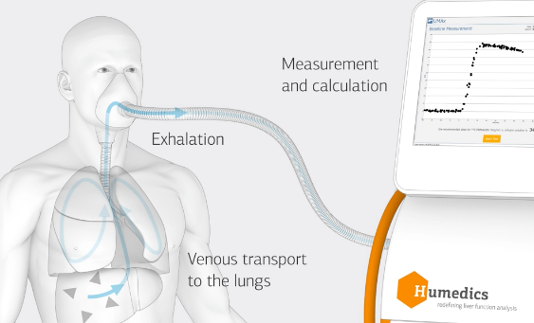
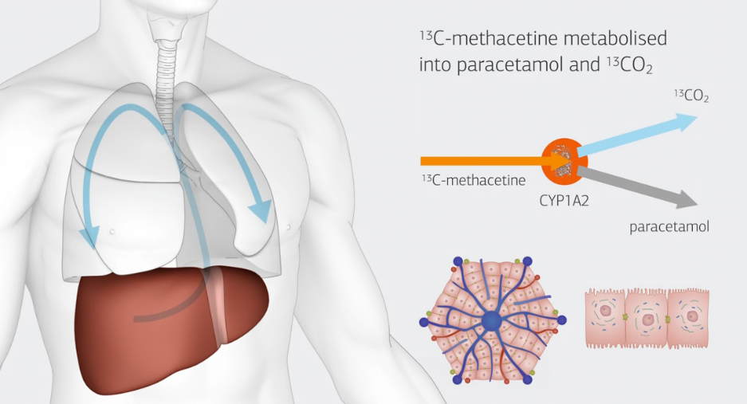
29. PREOPERATIVE EVALUATION OF LIVER FUNCTION CAPACITY IN MORBIDLY OBESE PA- TIENTS UNDERGOING BARIATRIC SURGERY Schmitz et al
Methods: Prospective study, 106 patients evaluated with LiMAx ® (liver function capacity) preop with calculated NAFLD fibrosis score, compared with NAFLD activity score on biopsy specimens postop.
  LiMAx ® test:
Results:
  Sensitivity 84%, Specificity 81%
  Without fibrosis median test score = 351 μg/kg/h
  With advanced fibrosis = 248 μg/kg/h
Conclusion: Liver function capacity correlates with histological and clinical
Scoring systems. LiMax test is suitable to screen for NASH

Slide 52
31. THE PREVALENCE AND IMPACT OF TRACE MINERAL DEFICIENCIES FOLLOWING BARIAT- RIC SURGERY: AN OBSERVATIONAL COHORT STUDYS. Abott Birmingham NHS UK
Consecutive patients after LAGB, RYGB & SG at a single centre in the UK between Jan 2016 & Nov 2016 had Biochemical and anthropometric data collected from the electronic patient records pre-operatively and at 6 weeks, 6 months and 12 months post-operatively
138 patients, of which 44.2% had RYGB (n= 61), 34.8% had SG (n= 48) and 21.0% had LAGB (n= 29).
Pre-operatively, 5.1% and 11.6% of patients had zinc and selenium deficiency.
The prevalence of zinc and selenium deficiencies increased following all BSs at 12 months (LAGB: +2.6%, +9.2%; SG +9.2%, +16.7%, RYGB +17.8%, +16.6%).
In the sub-group with T2DM, following adjustment for gender, age, baseline weight, pre-operative HbA1c, bariatric procedure and 12 month weight loss (%) (R2 = 0.879); lower pre-operative selenium levels predicted higher HbA1c at 12 months (B= -0.228, p= 0.017).
Conclusion: Zinc and selenium deficiencies are common post bariatric surgery and worsened from pre-surgical levels across all three procedures.
Clinicians and surgeons should be vigilant and examine for these deficiencies and treat accordingly for LAGB and SG, but even more so for RYGB.
Pre-operative selenium deficiency seems to have an impact on glycaemic control 12 months after surgery.

Slide 53
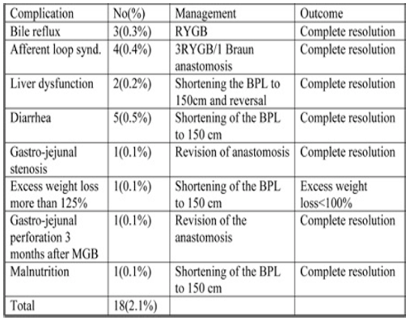
31. MGB & LIVER DYSFUNCTION: UK MGB/OAGB COLLABORATIVE GROUP
Aim: to discuss the UK experience with the diagnosis, management and prevention of liver dysfunction following MGB/OAGB. This is part of the UK MGB/OAGB collaborative group project.
Methods: The data of MGB/OAGB performed between 2010-2017 were analyzed.
Results: 845 patients over 7 years Median age 44 yrs, M:F 2:1 , DM type II 26% BP limb length 150 -300 cm Complications were 2.1% Two patients (0.2%) developed deranged liver function. The BP limb in both patients was 300 cm. Both revised by shortening the biliopancreatic limb to 150 cm and a reversal in the second patient. The follow-up of 2.5 years showed normal liver function.
Conclusion: 44% of Cx can be prevented if BPL 150-200cm MGB/OAGB biliopancreatic limb length should be kept to 150-200 cm to avoid liver dysfunction.

Slide 54
32. CHOLESTATIC AND INFLAMMATORY LIVER FAILURE LEAD TO DEATH AFTER OAGB A. Pazouki et al Iran
Introduction: One Anastomosis gastric bypass (OAGB)/MGB is now a widespread and generally acceptable procedure with excellent outcomes. Some situations after OAGB/MGB are critical and may lead to catastrophic outcomes. One of these situations is liver failure that must be managed based on its etiology.
Objectives: The aim of this study is about classifications of liver failure and their proper management. Also case series of 4 cases mortality after OAGB/MGB due to liver failure.
Methods: We evaluate the outcomes of OAGB/MGB based on registered data in Iranian obesity surgery database. A case series about etiologies of liver failures leads to death after OAGB/MGB.
Results: In about 5000 morbid obese patients that underwent OAGB/MGB in 5 high volume hospitals, by 5 surgeons, 4 mortalities occurred due to acute liver failure that were registered in Iranian obesity surgery database.
Conclusion: Punctual evaluation and regular follow ups are necessary after OAGB/MGB and any alteration in liver enzymes must be checked carefully. The etiology of liver failure must be specified and managed individually.

Slide 55
26. GASTRIC POUCH RESIZING FOR WEIGHT LOSS FAILURE AFTER ONE ANASTOMOSIS GASTRIC BYPASS Poghosyan, Chevallier et al
Methods: Retrospective review of 1585 patients found 15 underwent Gastric Pouch Resection (GPR)
Reason for investigation: Weight loss failure after OAGB
Results:
  After workup: 15 with dilated pouch on UGI series.
  Mean weight & BMI :
    137±18kg and 45.2±4.3kg/m² before OAGB
    113±24kg and 35±2.5kg/m² at GPR
  All GPR were laparoscopic
  One (11%) Cx: splenic infarct
  At 2 yrs Mean BMI 35±2.5kg/m² → 31±3.6Kg/m²
Conclusion: GPR is allows further weight loss on selected patients

Slide 56
O (248) LAPAROSCOPIC PARESOPHAGEAL HERNIA REPAIR IN PATIENTS WITH OBESITY: SINGLE INSTITUTION EXPERIENCE WITH CONCOMITANT REPAIR AND ROUX-EN-Y GASTRIC BY- PASS
H. Fayazzadeh et al. Cleveland, USA
Patients with symptomatic type 2-4 PEH, a body mass index (BMI) >30 kg/m2, had no prior PEH or bariatric surgeries
Concomitant laparoscopic PEH repair and RYGB between October 2009 and January 2018 were retrospectively identified
Preoperative comorbidities, PEH- related symptoms, operative details, 30-day morbidity and short term weight loss were abstracted.
Results:
81 patients mean age 54.9±10.8 yrs & BMI42.3 kg/m2
Type 3 PEH commonest type (91.4%)
Op time 188min & 10 (12.3%) had mesh reinforce
30-day complication rate was 16.0%
Respiratory complications (8.6%) and VTE (6.2%)
Follow up 82.7% at 1 year & 11.7 point BMI reduction
98% reported global symptom improvement
1 year, 10 (12.3%) radiographic or endoscopic recurrence (all type 1 PEH), and 2 were symptomatic.
Conclusions:
Concomitant RYGB with PEH is safe and feasible. Substantial weight reduction at 1-year likely contributes to low PEH recurrence rate.

Slide 57
O (251) QUALITY OF LIFE BEFORE AND AFTER LAPAROSCOPIC SLEEVE GASTRECTOMY. A PRO-SPECTIVE COHORT STUDY WITH FIVE YEARS FOLLOW UP.
Patients for LSG, over a 30-month period, were prospectively studied.
QoL assessed - MAII questionnaire and a visual analogue scale (VAS), preop and at 6, 12, 24&60 months postop
Anthropometric data & co-morbidities were recorded.
Results:
5 yrs follow up, 95 pts, BMI of 48.3±7.1kg/m2
%EBMIL was 51.7±14.2, 64.8±16.9, 67.4±17.7 and 55.8±25.5 at 6, 12, 24&60 months, respectively
Postop all comorbidities improved significantly
MAII score increased from -0.38±1.3 preoperatively to 1.77±0.8, 2.08±0.8, 2.12±0.7 and 1.67±1.1 at the above time-points, respectively (trend p<0.001)
VAS increased from 3.05±1.6 to 9.11±1.0, 9.2±1.1, 9.03±1.3 and 7.85±2.4 (P <0.001)
Overall QoL scores at 6&24 months (p<.001)
Female gender, correlated with higher QoL at the end of study
Conclusions:
LSG, is an effective bariatric operation, resulting in significant weight loss and improvements in QoL. Female gender and higher MAII score at 6 and 24 months, predict better long-term QoL out- come
V. Charalampakis et al. NHS. UK

Slide 58
O (267) OUTCOMES OF BARIATRIC SURGERY IN GERIATRIC PATIENTS: A SINGLE INSTITUTION STUDY
M. Bhandari Mohak India
Retrospective review for 184 geriatric patients (Range 65 to 80 years) who had undergone bariatric surgery at a single institution from Jan 2010 to Dec 2013
Results:
53(28.8%) RYGB, 39(21.2%) OAGBP & 92(50%) SG
Average preop weight and BMI were 106.71±19.42 kg and 42.59±7.01 kg/m2, respectively
Median length of follow-up was 36 months (range 1-43)
% EBWL was 74.55% at 36 months
No mortality was recorded during this period
Resolution and amelioration of co-morbidities similar in adult and geriatric patients.
Conclusion:
Bariatric surgery was effective for geriatric patients with a low morbidity and mortality rate. The weight, BMI and % EBWL are same as reported in adult patients

Slide 59
O (021) First things first: pregnancy or bariatric surgery? The effect of bariatric surgery on pregnancy and neonatal outcome
L Heusschen Rijnstate Netherlands
75 Pregnancies following bariatric surgery and 64 control pregnancies in obese (BMI ≥ 30 kg/m2) non-operated women were evaluated.
75 Pregnancy after Bariatric Surgery
Weight gain 7.3
Gestational DM OR 0.06
C-section OR 0.30
Birth Wt 3267
Birth length 49.9
Age percentile 46.7
Risk of Large for Gestational age OR 0.31
64 Obese patients
Weight gain 12.4 P=0.001
Gestational DM CI 0.01-0.45
C-section CI 0.12-0.77
Birth Wt 3693 P<0.001
Birth length 51.8 P<0.001
Age percentile 70.9 P<0.001
Risk for Large for Gestational age CI 0.13-0.76
The most frequently diagnosed deficiencies were for ferritin, vitamin A, vitamin B12, vitamin D and albumin. Only one patient was found to have a slightly elevated vitamin B6 and no elevated levels were found for vitamin A.
Conclusion: Despite current recommendations, pregnancy within the first twelve to eighteen months post-surgery seems safe. General Practitioners should recommend just one year delay in becoming pregnant after surgery.
Special obstetric attention on fetal growth and maternal nutritional status including multivitamin use.

Slide 60
O (025) Utility of Immediate Post operative UGI contrast studies in Bariatric Surgery
E. Elli May Jacksonville Florida
283 patients (215 Females; mean age: 48 yo) after LSG & RYGB from Jan 2016–Oct 2017 (69.4% had UGI 197/283).
We compared the use vs nonuse of routine POD#1 UGI contrast study and the early postoperative outcome (30 days); the difference between their (LOS) and the cost-effectiveness of the study.
RYGB (69.4%)196/283 98 with UGI study
99 without UGI study
1 SBO in RYGB (0.5%)
UGI negative in all.
LOS 1.8 (0.9) days with UGI & 1.8 (1.6) without UGI study
LSG 30.6% (87/283)
30 with UGI study
57 without it
1 leak (1.1%)
UGI negative in all.
LOS 2 (1.2) with UGI & 1.9 (0.1) without UGI study
The overall cost of a postoperative UGI contrast study was 600$ resulting a total of an additional 75,000$.
Conclusion: The routine use of postoperative UGI contrast study after SG and GB lacks clinical value for the detection of leaks, especially due to the delay in the clinical presentation. Furthermore the routine use of the study does not decrease patient LOS and increases procedure costs.

Slide 61
O (195) CAUSES AND MANAGEMENT OF REVISIONAL SURGERY AFTER MGB/OAGB UK MGB/OAGB COLLABORATIVE GROUP Hussain et al
O (188) IS THE FRIDAY/WEEKEND EFFECT REAL? A RETROSPECTIVE CLINICAL COHORT ANALY- SIS OF LENGTH OF HOSPITAL STAY OF PATIENTS UNDERGOING BARIATRIC PROCEDURESDevabalan et al
Conclusion: Friday LRYGB stayed longer than weekday or weekend LRYGB, increasing the financial burden on NHS in UK.

Slide 62
O (079) PREOPERATIVE PREDICTORS OF EARLY RELAPSE OF TYPE 2 DIABETES AFTER META- BOLIC SURGERY IN CHINESE PATIENTS Liang et al
Methods: Retrospective review of 101 patients who underwent RYGB or loop DJB with Sleeve (LDJB-SG). Reason for investigation:
Why some relapse early? Mulitvariate with logisitic regression.
Results: 19 patients had early relapse.
Mean weight & hip circumference were less in relapsers (82.81 kg vs 96.66 kg) & (105.2cm vs 112.5 cm)
DM > 2yrs duration was independently associated with higher relapse
Conclusion: DM > 2 yrs the most independent preoperative predictor of early relapse.

Slide 63
15. RYGB, LSG & OAGB AS RESCUE THERAPY AFTER FAILED LAGB: A MULTI- CENTER STUDY WITH 1219 PATIENTS Rafols et al Seven (7) Bariatric centers
1219 Patients
74.2% LRYGB
15.7% OAGB
10.1% LSG
Mean Age 38.2 yrs (+- 10.5) Females 82.5%
Complications 11.8 %: Leak 4.1% , Bleeding 3%
EWL > 50% : 74.5% LRYGB, 88% OAGB, 76.3% LSG
Conclusion: All procedures achieve significant weight loss.

